Slide 1

CHORBADJIITE
More than just a team

Slide 2
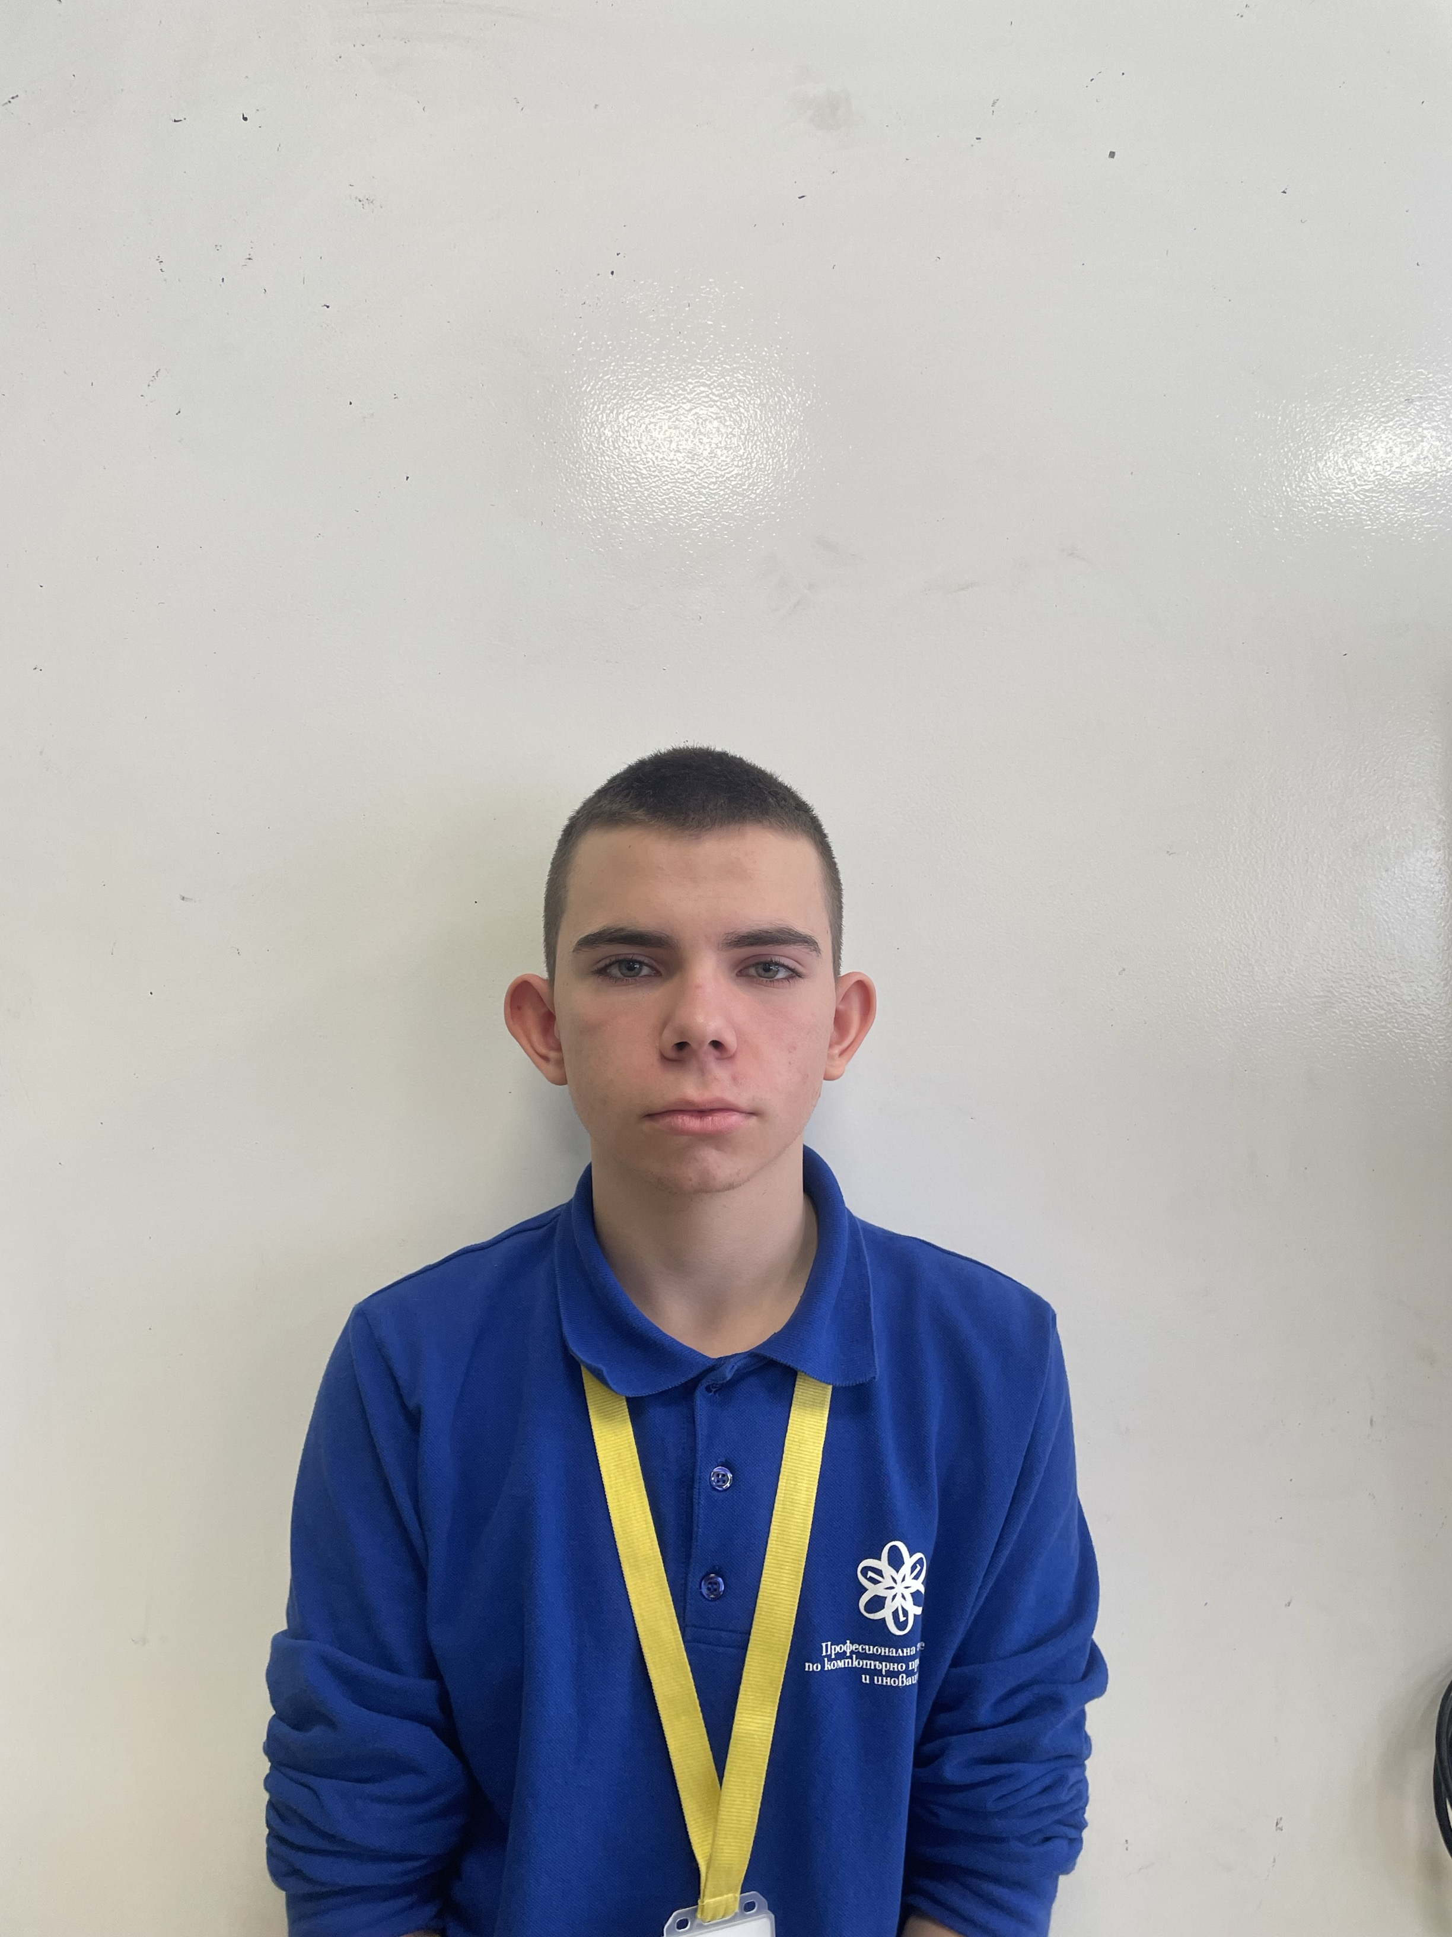
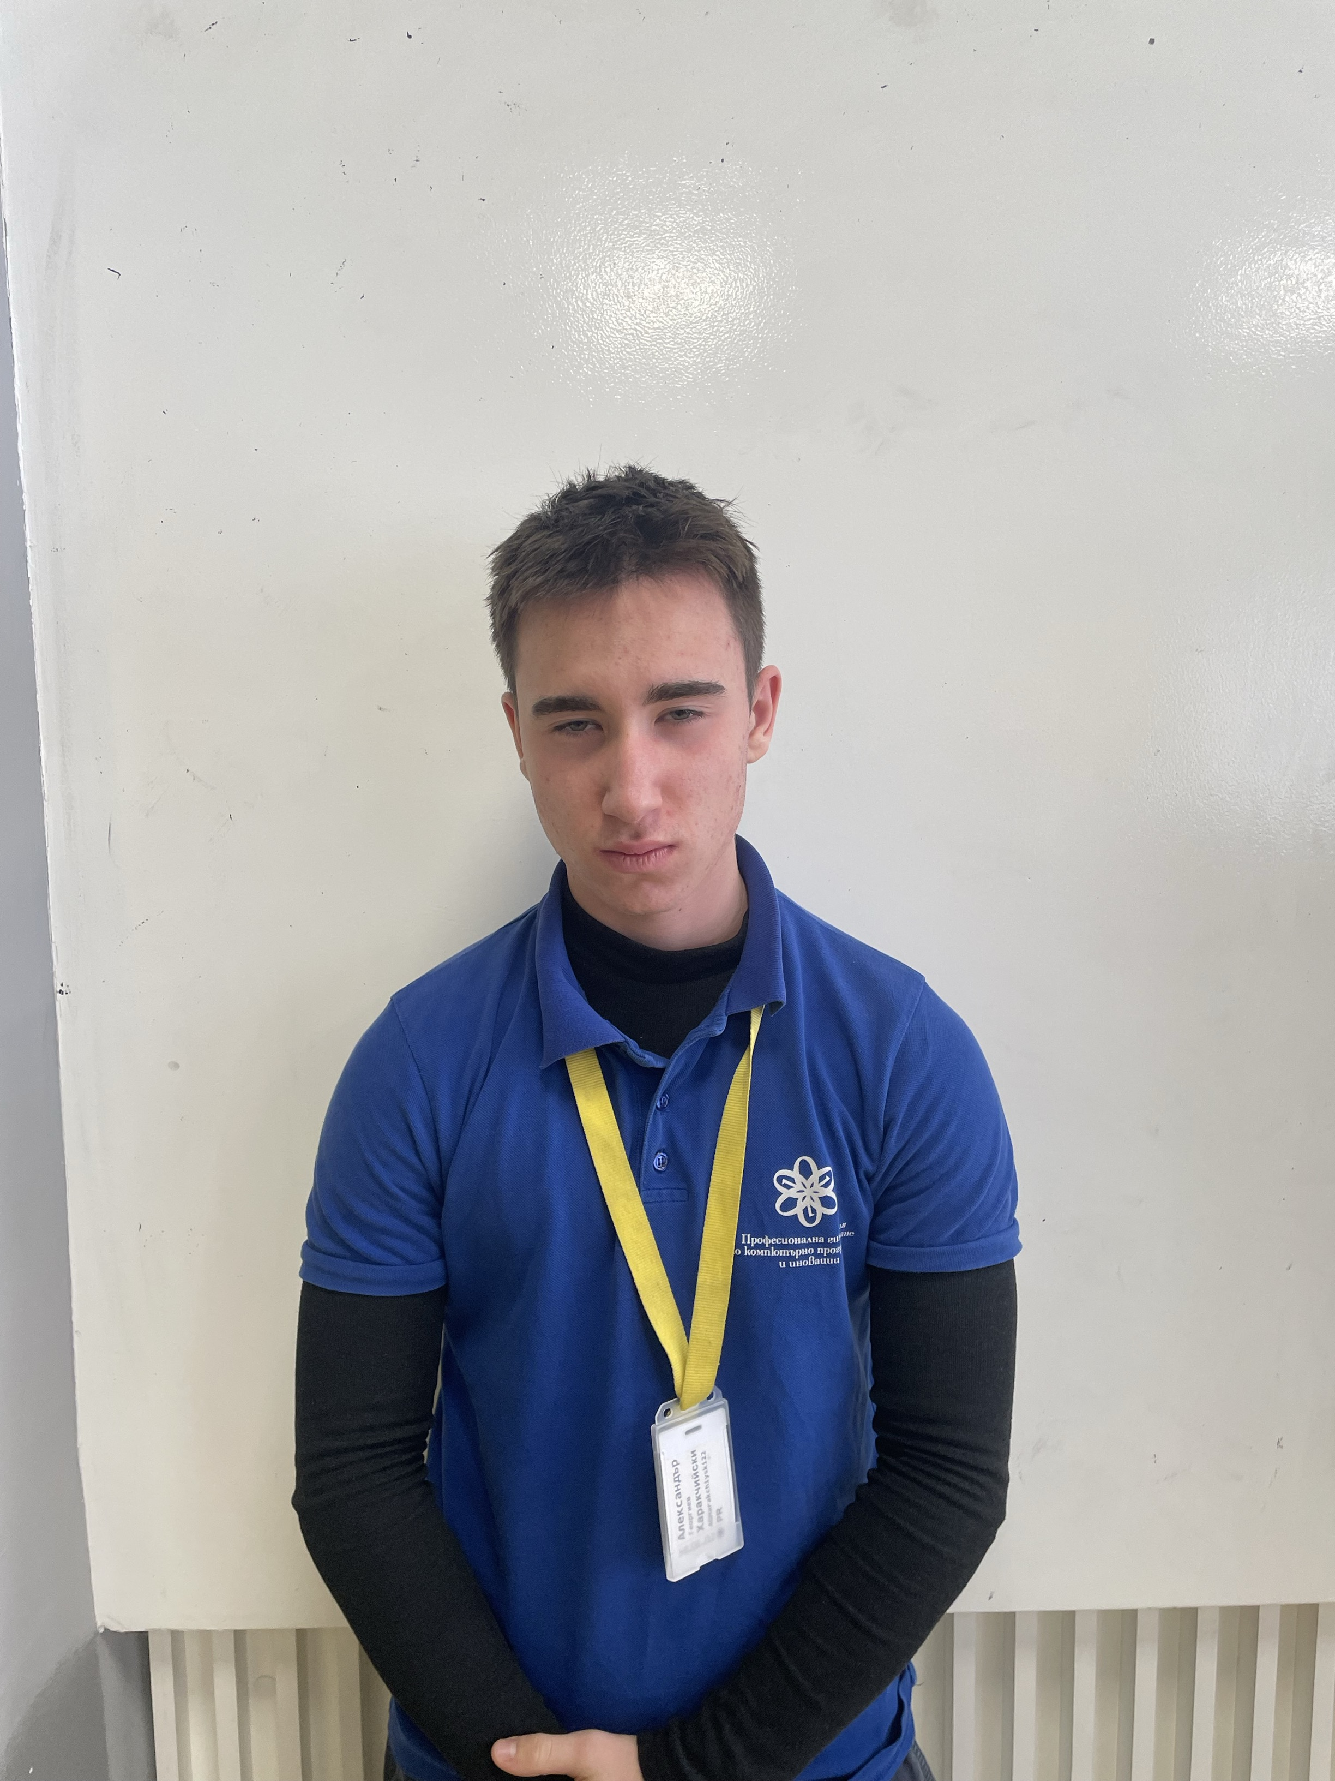
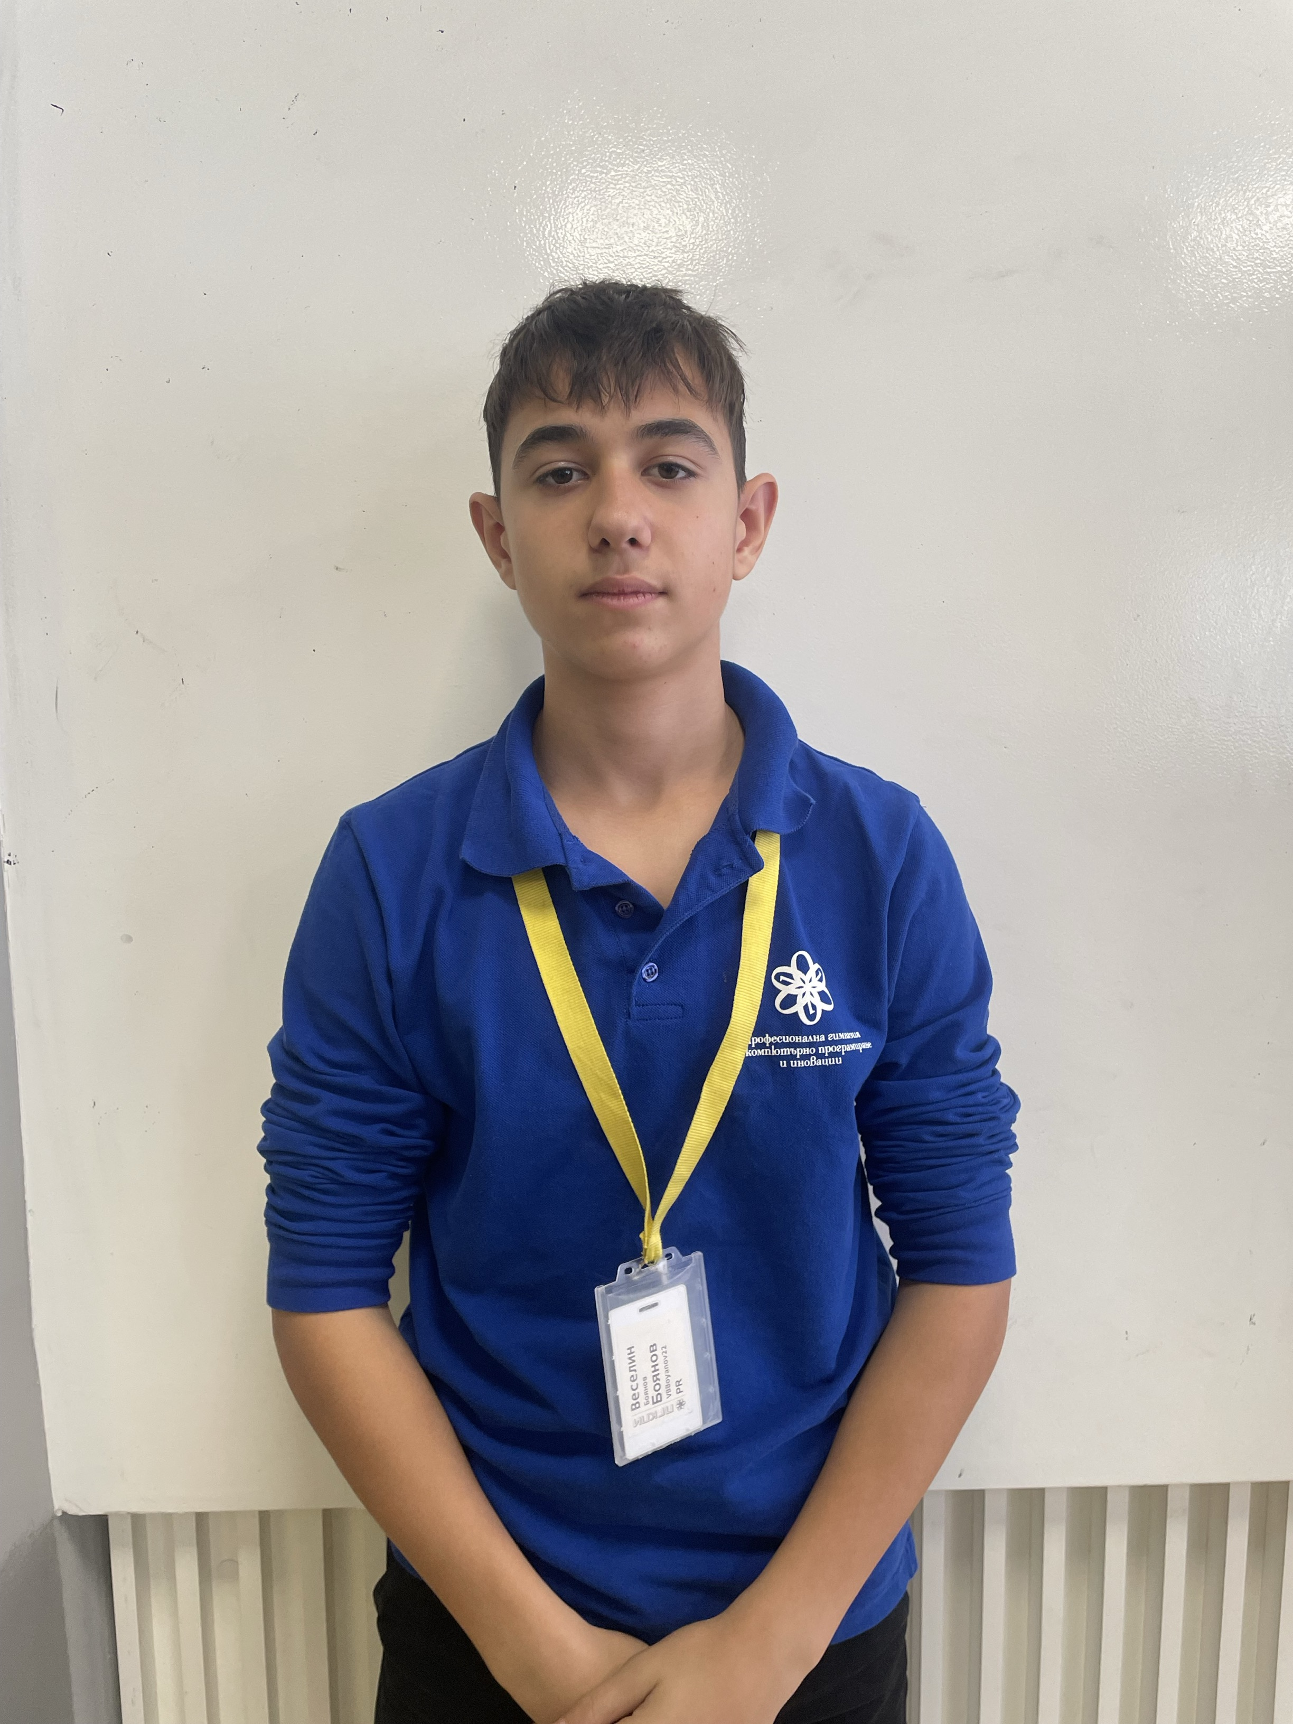
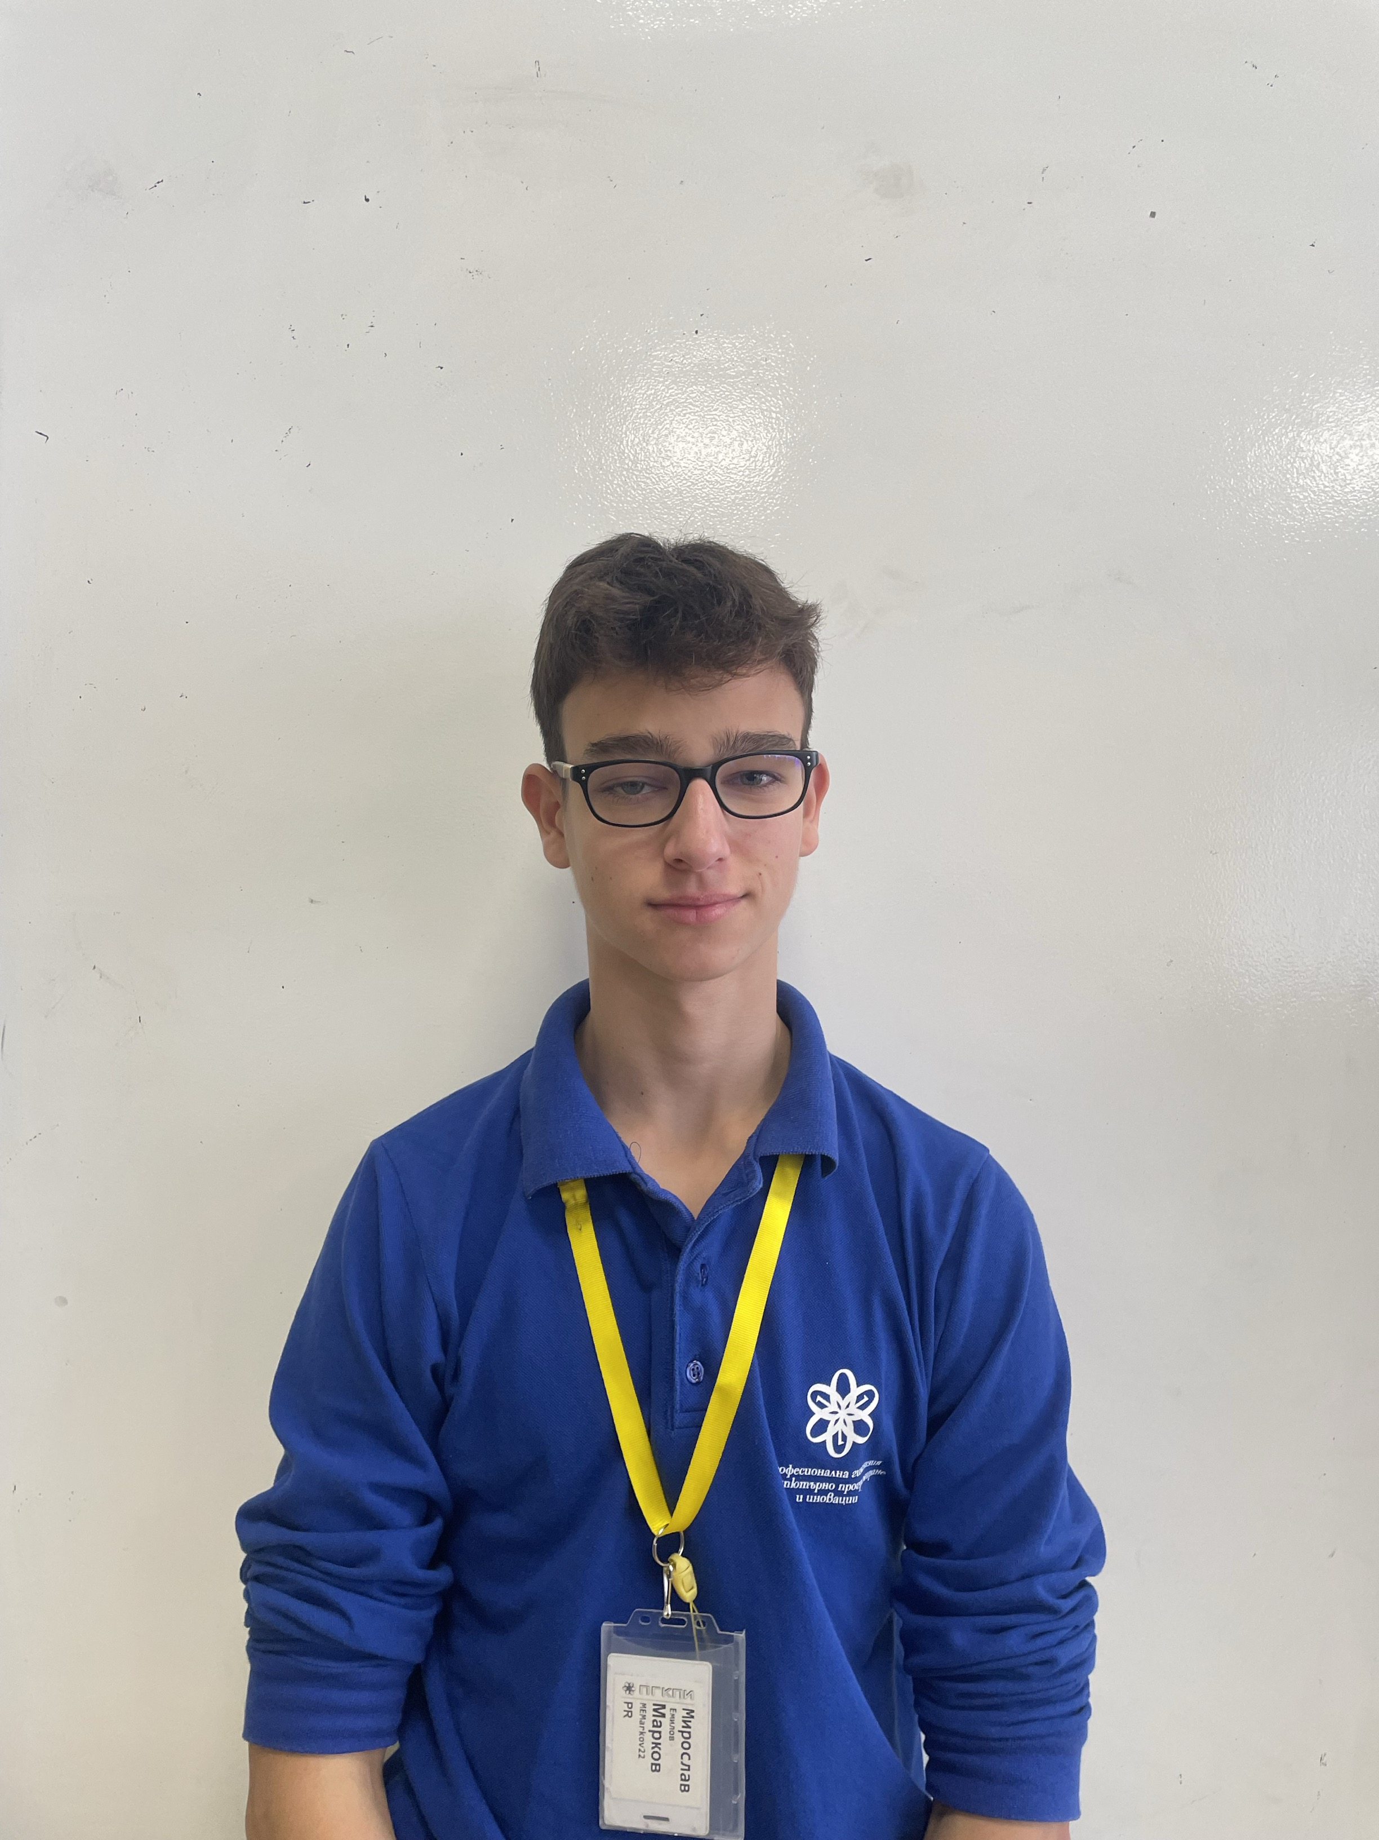
OUR TEAM
Konstantin Nachev
Aleksander Harakchiyski
Veselin Boyanov
Miroslav Markov
Scrum trainer
Front-end developer
Front-end developer
Designer
Konstantin Nachev
Konstantin Nachev

Slide 3


OUR IDEA

Slide 4


STAGES OF DEVELOPMENT

Slide 5










THE PROGRAMS WE USED

Slide 6
LET'S GO TO OUR PROJECT!

